Slide 1

Toronto Canada or New York usa
By Denis Ivanov

Slide 2
Problem statement
Analyze the similarities and differences between Scarborogh in Toronto and Queens in New York City.
Based on variety and number of venues show the best place for companies to establish their presence to attract most skillful employees.

Slide 3
Objective
By using Foursquare show neighborhoods with top venues
By using unsupervised k-mean clustering technique group neighborhoods based on venue categories
Find and show differences and commonalities between both Scarborough, Toronto and Queens, New York

Slide 4
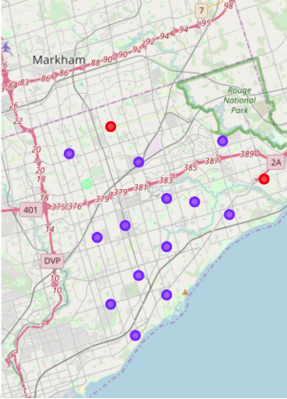
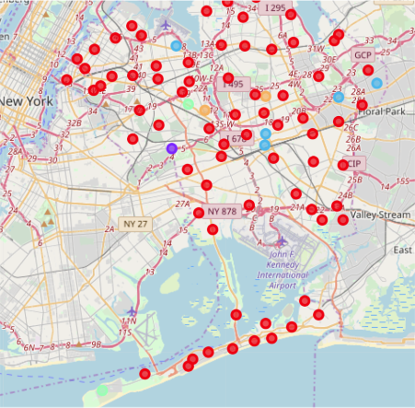
Maps
Scarborough, Toronto
Queens, New York

Slide 5
Comparisson
Scarborough, Toronto
Queens, New York
79 distinct venues in 52 categories
Most common venues are coffe shops, international restaurants, skating rinks
1760 distinct venues in 269 categories
Most common venues are bodegas, bakeries, coffee shops and parks

Slide 6
Conclusion
Looking at number and variety venues Queens, New York may be a better choice for both companies and their employees. As you may see Queens New York has more grocery stores, restaurants, gyms and parks that would attract more employees.

